Slide 1
CORPORATE FINANCE PROJECT REPORT
Smart Parking System
Near Square Hospital, Dhaka
Feasibility, Financing & Capital Budgeting Analysis
East West University | Principles of Finance (FIN101) | Section 10 | Group 03 | Summer 2026
Submitted to: Dr. Md Rafiqul Matin, Adjunct Professor Date: 24 August 2026
SUBMITTED BY: GROUP 03
Muhammad Abdul Kayum
2023-2-60-082
Linkon Saha
2024-3-60-314
Zarin Tasnim Maisha
2023-2-60-184
Nawar Salsabil Fiha
2024-3-60-172
Mahina Hoque
2023-3-60-085
Nafisa Tasnim Rafia
2024-3-60-174
Lameya Suman Mahin
2024-1-30-012
Fatimah Atiyyatul Karim
2025-2-27-081
Notes:
Opening slide. Introduce the group, the course, and the topic: a feasibility study for a technology-enabled Smart Parking System located near Square Hospital in Dhaka. Mention this is a full corporate finance capital budgeting exercise — from the business idea through to an accept/reject investment recommendation. Quickly acknowledge all 8 team members and note that each part of the report will be presented by a different member. Keep this to under 30 seconds.

Slide 2
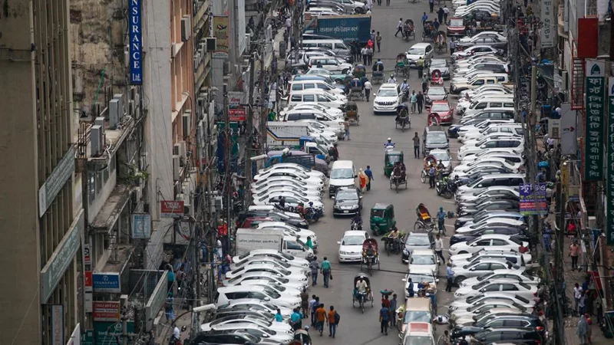
Dhaka parking problem: demand is concentrated where footfall is high
Part 1
What creates the business opportunity?
Rapid urbanization and private vehicle growth increase parking demand.
Hospitals, universities and commercial areas create recurring, high-footfall demand.
Informal roadside parking can be insecure, unregulated and congestion-producing.
Customers value convenience, availability and faster entry/exit, not just a parking slot.
Business implication: a reliable off-street solution can monetize convenience.

Slide 3
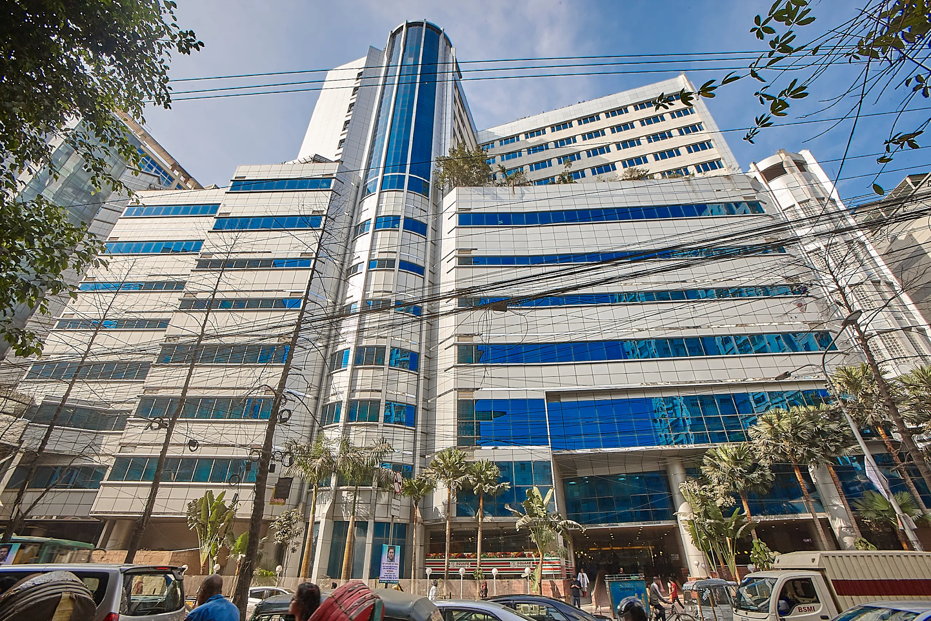
Site context: Square Hospital area
Part 1
Project location logic
Hospital proximity
200–300 m walking distance
Project capacity
100 cars + 60 motorcycles
Demand windows
8:00–11:00 AM and 3:00–7:00 PM
Core users
Patients, attendants, staff, visitors
Facility concept
Multi-level, controlled entry/exit

Slide 4
Demand profile: multiple customer segments, concentrated peaks
Part 1
Part 1
Patients & attendants
Doctors & nurses
Employees & visitors
Other nearby users
High urgency
Recurring
Recurring / variable
Opportunistic
Need certainty and short search time
Potential subscription demand
Security and convenience matter
Incremental occupancy outside peaks
Peak demand windows
The operating model therefore benefits from a base of recurring demand across the day, with stronger occupancy during institutional peak periods.
8:00–11:00 AM
3:00–7:00 PM

Slide 5
Proposed solution: a technology-enabled multi-level parking facility
Part 1
1
2
3
4
5
6
Reserve
Arrive
Enter
Park
Pay
Exit
Mobile app / availability check
ANPR identifies vehicle
Boom barrier + slot allocation
Occupancy sensor updates system
Cashless payment / subscription
ANPR confirms exit
Core technology layer
Why it matters financially
IoT occupancy sensors
ANPR + automated barriers
Mobile reservation + cashless payment
CCTV and central management dashboard
Faster turnover can support higher effective utilization.
Subscriptions can create recurring revenue.
Automation can reduce friction and manual processing.

Slide 6
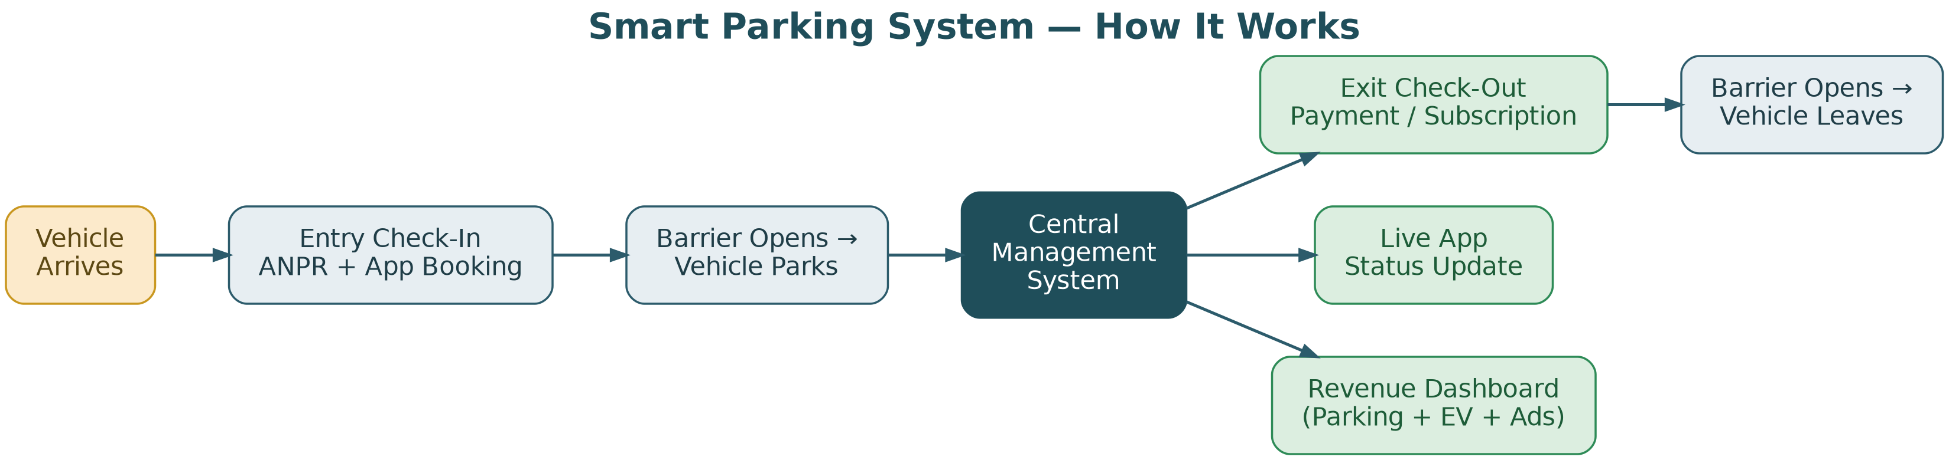
Operating workflow: from arrival to revenue capture
Part 1

Slide 7
Service design and capacity
Part 1
Car bays
Motorbike bays
Operating days
Ancillary revenue
100
60
350
+10%
Four-wheelers
Two-wheelers
Per year assumption
EV charging + advertising
Design principles
Off-street, organized parking
Controlled entry and exit
Real-time availability and reservation
Broad vehicle mix
Scalable operating model
Revenue channels
Parking fees
Primary
Monthly subscriptions
Recurring
EV charging / bay rental
Ancillary
On-site advertising
Ancillary

Slide 8
Business objectives translated into value drivers
Part 1
Objective
Business driver
Financial implication
Safe, organized parking
Higher trust / lower friction
Supports paid occupancy
Reduce congestion
Shorter search time
Higher service attractiveness
Improve convenience
Reservation + reliable access
Supports repeat users
Technology-based management
Automation + monitoring
Scalability / operating control
Multiple revenue streams
Parking + subscriptions + ancillary
Lower single-stream dependence
Commercial viability
NPV, IRR, payback, PI
Investment decision

Slide 9
Market gap and competitive positioning
Part 2
Dimension
Informal roadside
Basic paid lot
Proposed smart parking
Availability visibility
Low
Low / manual
Real-time
Reservation
No
Usually no
Yes
ANPR / automated entry
No
Limited
Yes
Security / monitoring
Variable
Basic
CCTV + controlled access
Cashless payment
Variable
Possible
Core feature
Subscription model
No
Limited
Yes
Positioning: “organized + tech-enabled + convenient”

Slide 10
Industry and economic environment
Part 2
Vehicle & footfall growth
Parking demand remains supported by urban mobility and institutional traffic.
Demand
Inflation
Elevated inflation raises wages, utilities and maintenance costs.
Cost
Urban migration
Expansion of hospitals, universities and commercial activity supports footfall.
Demand
Fuel / traffic policy
Restrictions on roadside parking can shift users toward formal facilities.
Demand
Interest rates
Tighter monetary conditions raise project financing costs.
Financing

Slide 11
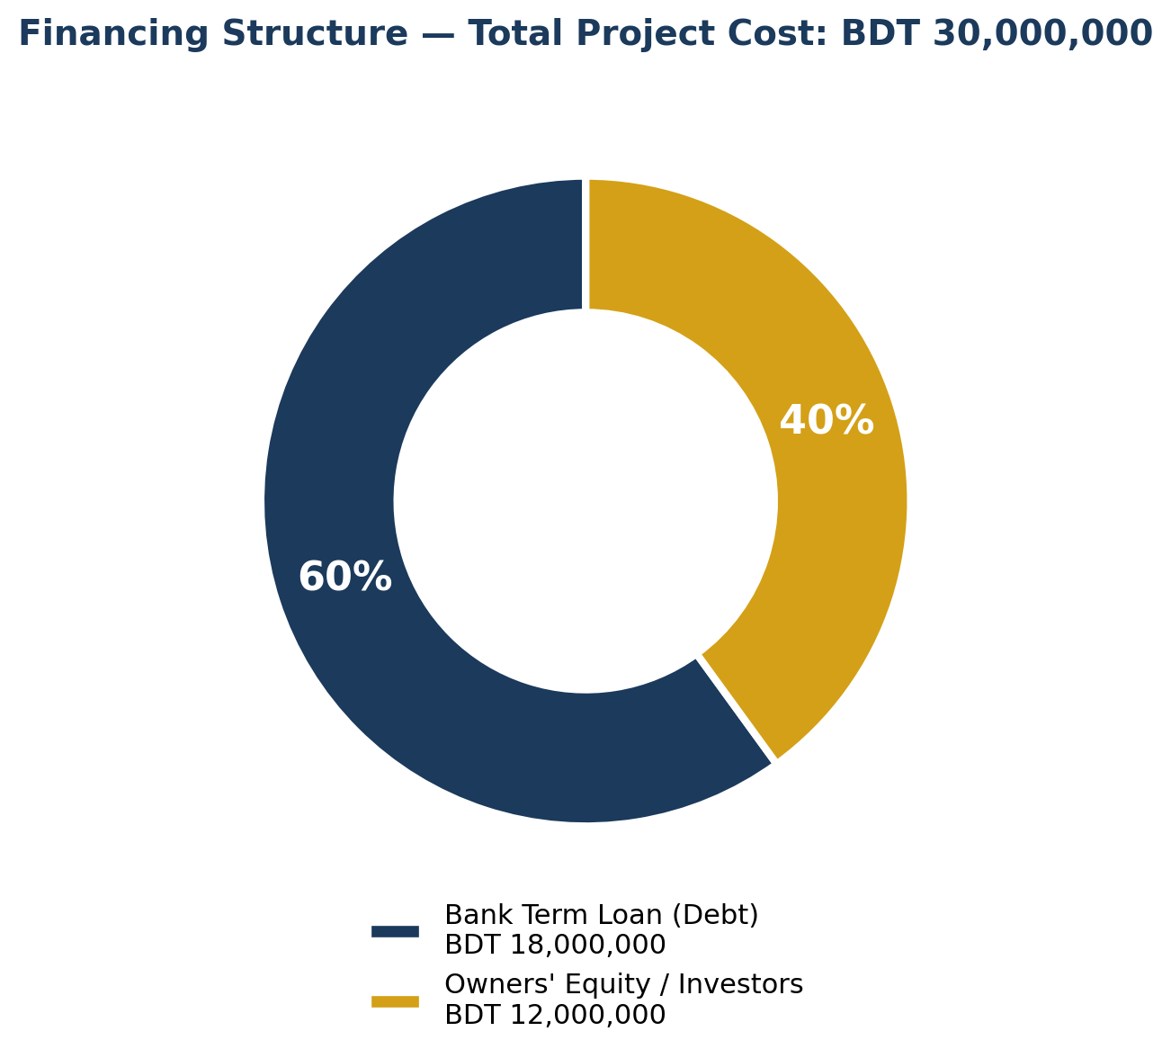
Financing plan: a blended 60/40 capital structure
Part 3
Total project financing
BDT 30,000,000
60% debt | 40% equity
Debt finances BDT 18.0M of the project.
Equity finances BDT 12.0M and absorbs residual business risk.
The mix is consistent with a project expected to generate predictable cash flows.

Slide 12
Debt financing
Part 3
Loan amount
Loan term
Interest rate
Tax benefit
BDT 18.0M
5 years
14.0%
10.15%
60% of total investment
Secured term loan
Pre-tax
After-tax cost
Financing logic
Secured against equipment and the lease / mortgage assignment.
Interest is tax-deductible, reducing the effective cost of debt.
Amortization over five years aligns debt service with the project’s operating cash generation.

Slide 13
Equity financing
Part 3
Equity capital
Investors
Fixed obligation
BDT 12.0M
Owners + private capital
None
40% of total investment
Illustratively 3–4 investors
Residual return profile
What equity is expected to finance
Finance principle
The portion of capital not funded by debt.
Residual cash flows after operating costs and debt service.
Upside from project value if the facility scales or expands.
Equity is more expensive than debt in this model because equity investors bear more residual risk and require a higher return.

Slide 14
Cost of debt
Part 4
Part 4
Pre-tax rate
Tax rate
After-tax cost
14.00%
27.50%
10.15%
Formula
R_{d}* = Pre-tax cost of debt × (1 − Tax rate) = 14.0% × (1 − 0.275) = 10.15%
This 10.15% figure enters the WACC calculation.

Slide 15
Cost of equity: CAPM
Part 4
Part 4
CAPM inputs
CAPM calculation
Risk-free rate (Rf)
11.0%
R_{c}= R_{f} + β × [ E(R_{m}) − R_{f} ]
Long-term government bond proxy
Beta (β)
1.20
= 11.0% + 1.20 × (16.0% − 11.0%)
Estimated project systematic risk
= 17.00%
Market return (R_{m})
16.0%
Broad DSE market proxy
Required return on equity

Slide 16
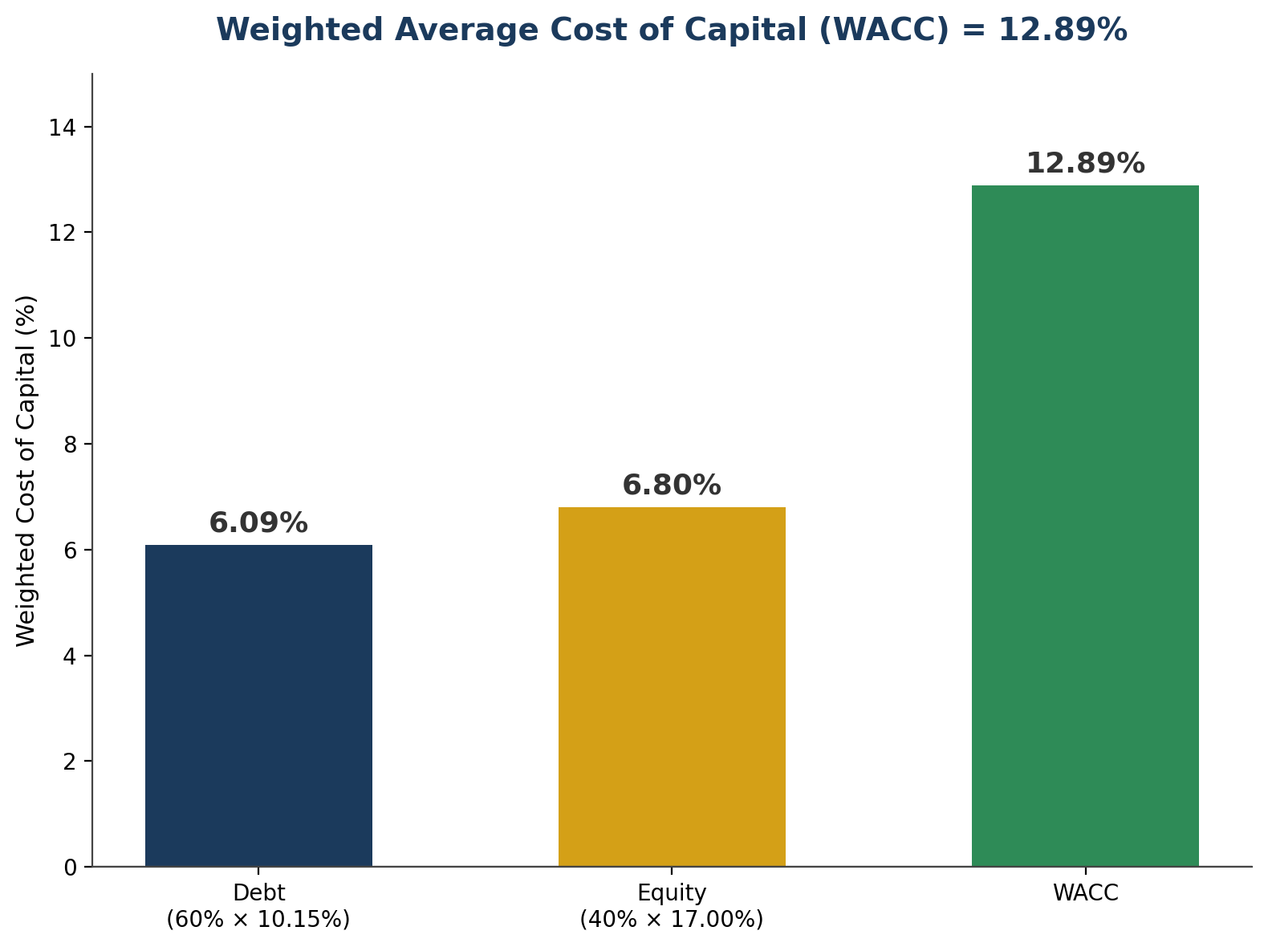
WACC: the project discount rate is 12.89%
Part 4
Capital source
Weight
Cost
Weighted cost
Debt
60%
10.15%
6.09%
Equity
40%
17.00%
6.80%
WACC
100%
—
12.89%
WACC = W_{d}R_{d}* + W_{c}R_{c}
WACC = (0.60 × 10.15%) + (0.40 × 17.00%) = 12.89%

Slide 17
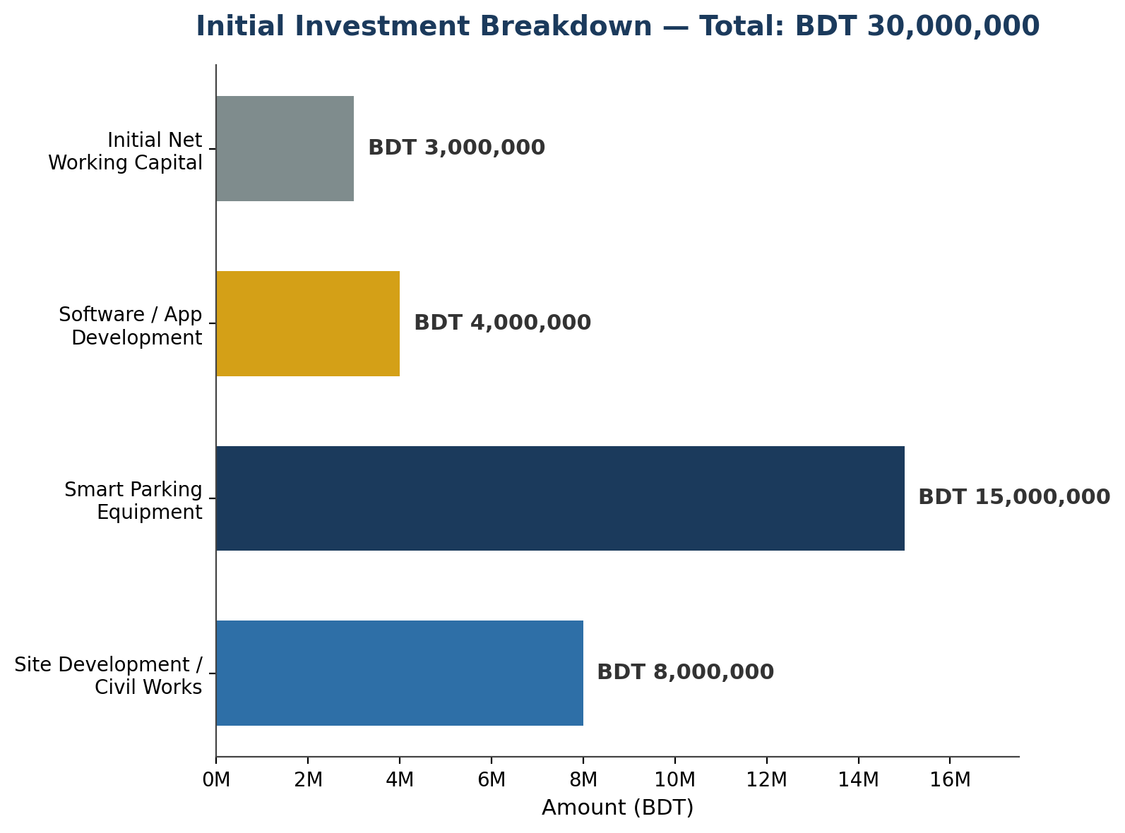
Initial investment: BDT 30 million
Part 5
Use of funds
BDT
Site development / civil works
8,000,000
Smart parking equipment
15,000,000
Software / app development
4,000,000
Initial net working capital
3,000,000
Total
30,000,000
Capex concentration
Smart parking equipment = 50% of total investment

Slide 18
Revenue assumptions
Part 5
Car parking
100 bays × BDT 400 × 350 days
BDT 14.000M
Motorbike parking
60 bays × BDT 150 × 350 days
BDT 3.150M
Ancillary revenue
10% of core parking revenue
BDT 1.715M
Year 1 total
BDT 18.865M
Growth assumption
Revenue grows 8% annually, reflecting occupancy ramp-up, vehicle growth and subscription expansion.
Core parking revenue = BDT 17.15M; +10% ancillary = BDT 18.865M

Slide 19
Operating cost assumptions
Part 5
Year 1 Opex
Annual opex growth
Year 1 EBITDA
BDT 5.328M
6%
BDT 13.537M
Operating cost base
Inflation-linked
Revenue less Opex
Key cost categories
Staff costs
8 employees
Utilities
Electricity + site utilities
Maintenance
Parking equipment + premises
Software / IoT
Platform upkeep
Insurance / rent
Site and risk costs
Marketing
Customer acquisition / awareness

Slide 20
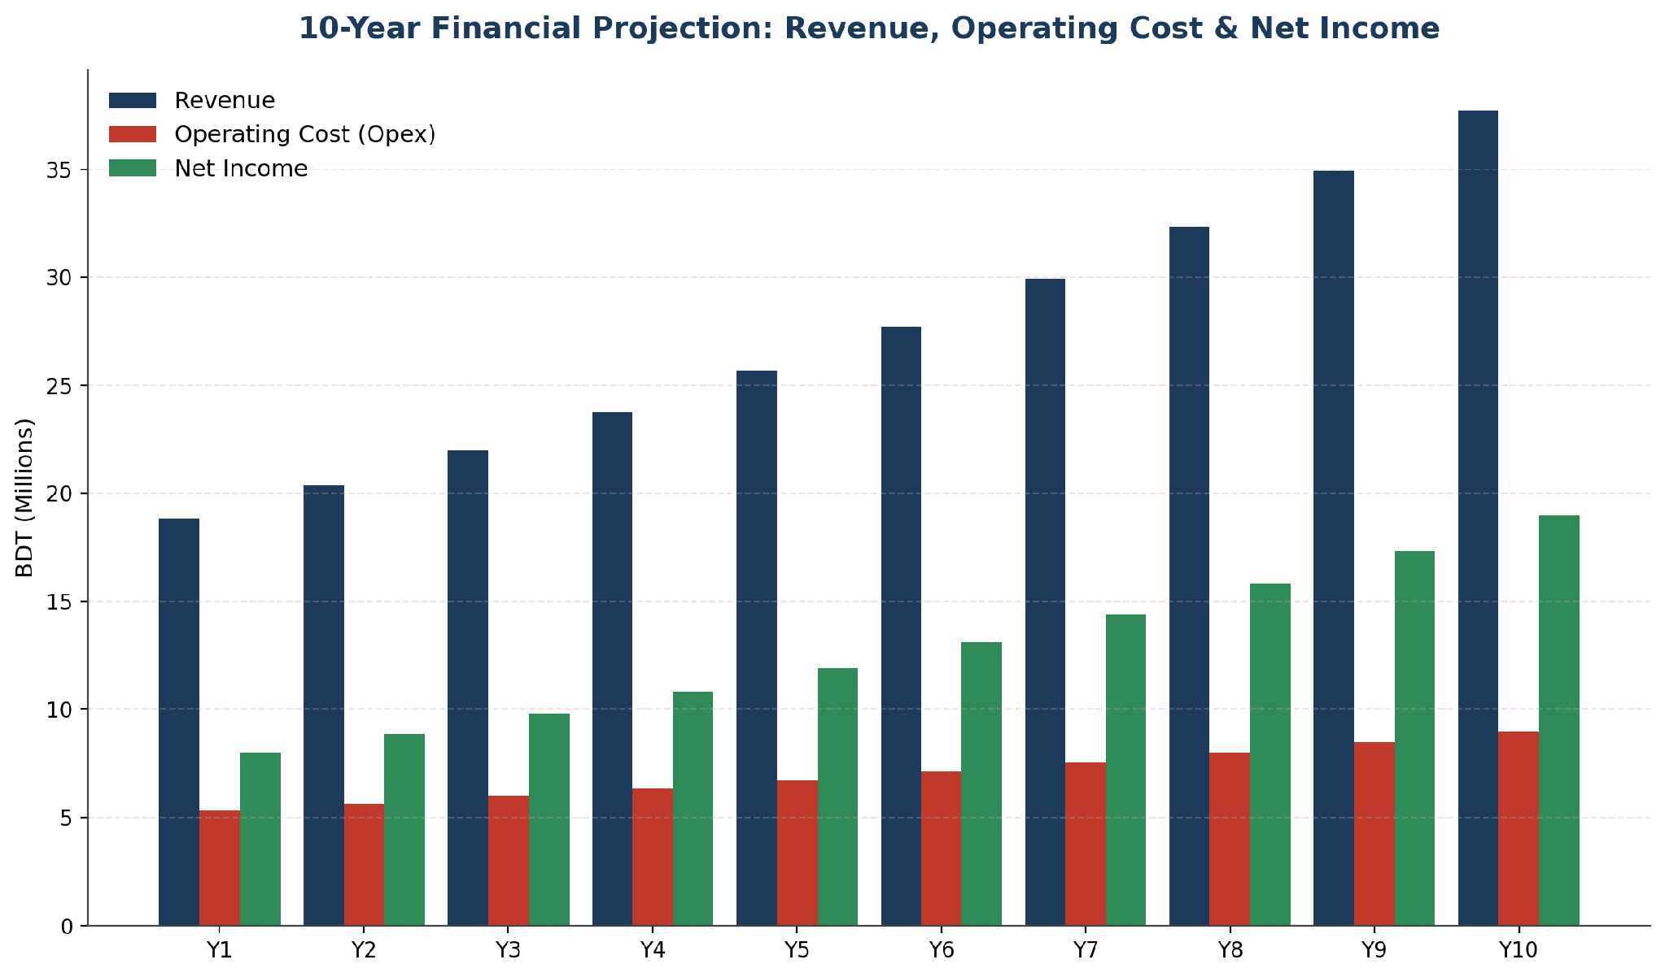
10-year financial trajectory
Part 5

Slide 21
Year 1 cash-flow mechanics
Part 5
Revenue
BDT 18.865M
− Opex
BDT 5.328M
Why depreciation is added back
= EBITDA
BDT 13.537M
Depreciation reduces EBIT and tax-bearing profit.
It is a non-cash accounting expense.
Therefore, it is added back when deriving operating cash flow.
− Depreciation
BDT 2.500M
= EBIT
BDT 11.037M
− Tax
BDT 3.035M
Year 1 operating cash flow
= Net income
BDT 8.002M
BDT 10.502M
+ Depreciation
BDT 2.500M
= Operating CF
BDT 10.502M

Slide 22
Projected cash flow: Years 1–5
Part 5
Year
Revenue
Opex
EBITDA
Operating CF
Y1
18.865M
5.328M
13.537M
10.502M
Y2
20.374M
5.648M
14.727M
11.364M
Y3
22.004M
5.987M
16.018M
12.300M
Y4
23.764M
6.346M
17.419M
13.316M
Y5
25.666M
6.726M
18.939M
14.418M
Operating CF increases from BDT 10.50M in Y1 to BDT 14.42M in Y5.

Slide 23
Projected cash flow: Years 6–10
Part 5
Year
Revenue
Opex
EBITDA
Operating CF
Y6
27.719M
7.130M
20.589M
15.614M
Y7
29.936M
7.558M
22.379M
16.912M
Y8
32.331M
8.011M
24.320M
18.319M
Y9
34.918M
8.492M
26.426M
19.846M
Y10
37.711M
9.002M
28.710M
26.502M
Y10 operating CF includes BDT 2.0M salvage value + BDT 3.0M working-capital release.

Slide 24
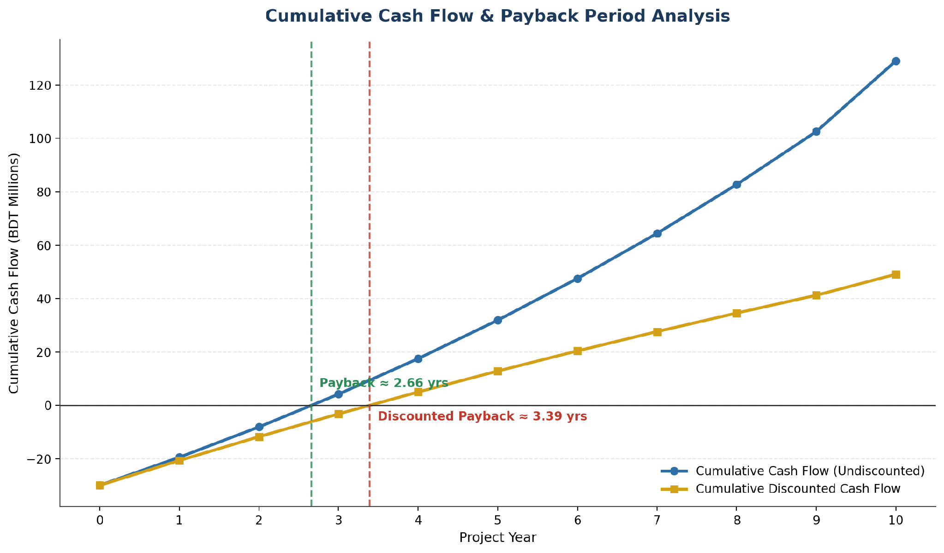
Cumulative cash flow and payback
Part 6
Payback Period
2.66 yrs
Target < 5 years
Discounted Payback
3.39 yrs
Within 10-year life
Decision: Passes both recovery tests.

Slide 25
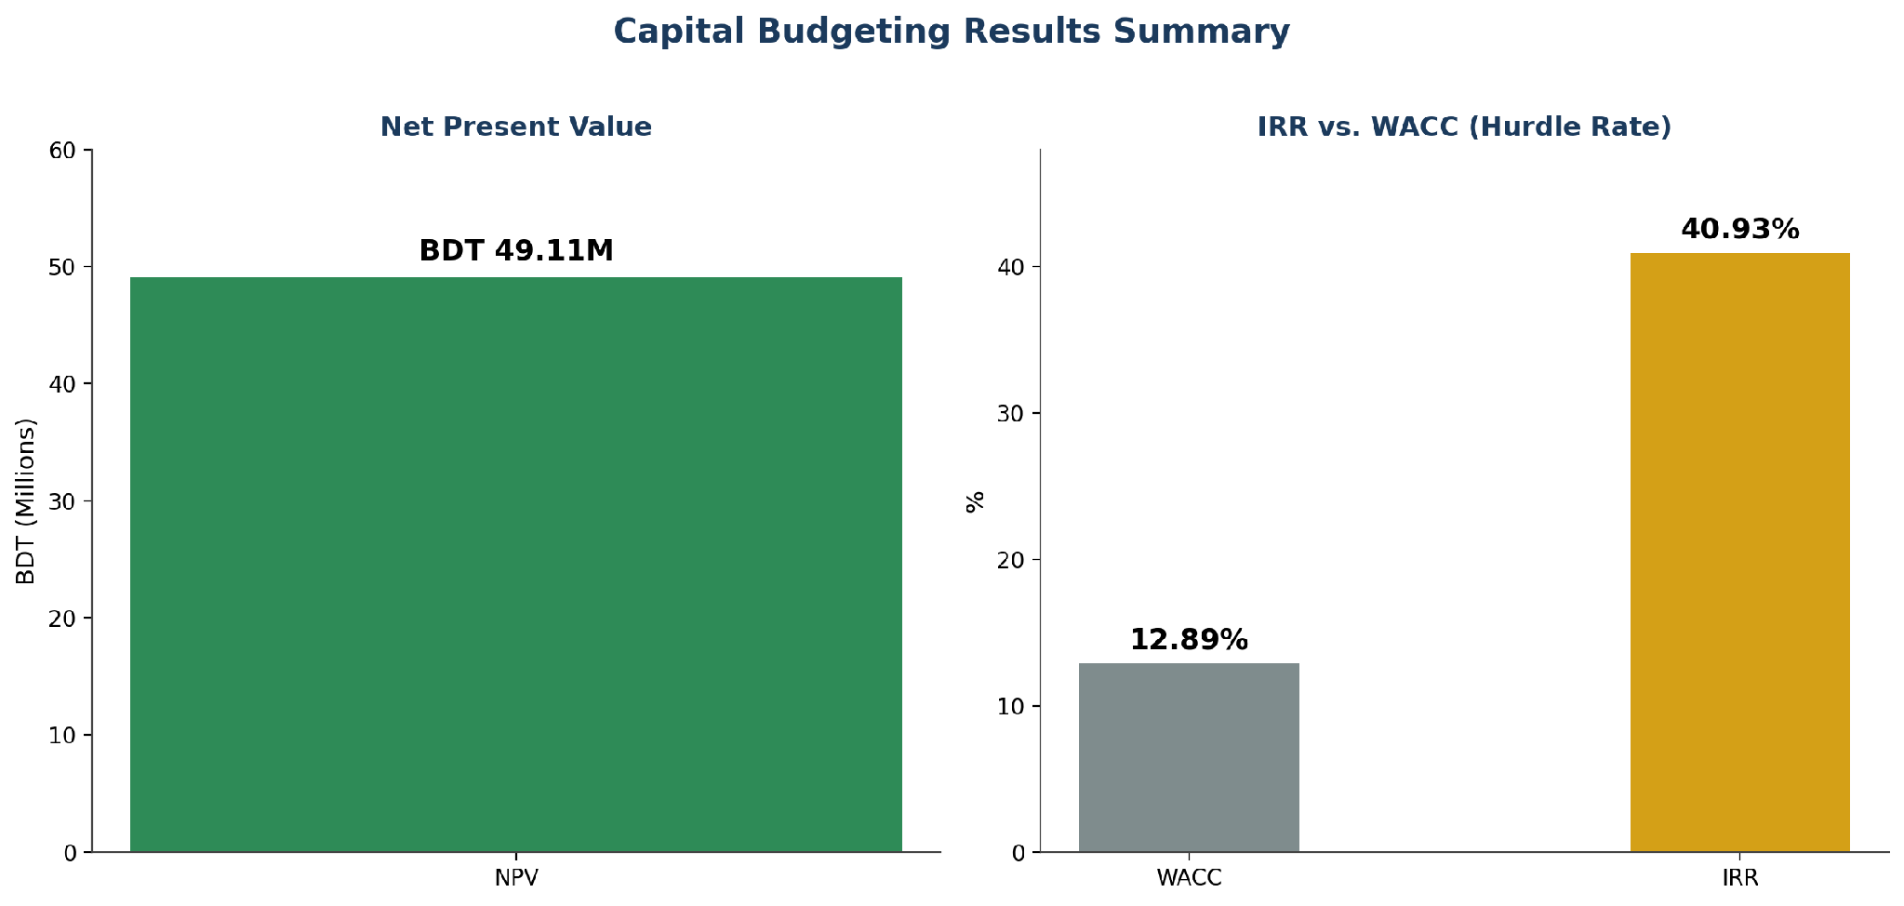
Capital budgeting dashboard
Part 6
NPV
BDT 49.107M
> 0 = Accept
IRR
40.93%
> WACC 12.89%
Payback
2.66 yrs
< 5 yrs target
Discounted payback
3.39 yrs
< 10-year life
PI
2.64
> 1.0 = Accept

Slide 26
NPV and IRR: the strongest value-creation signals
Part 6
Net Present Value
Internal Rate of Return
BDT 49.11M
40.93%
Decision rule: NPV > 0
vs. WACC 12.89%
Interpretation: the project is expected to add value after covering the required return on capital.
The 28.04 percentage-point spread provides a substantial buffer against moderate estimation error.

Slide 27
Profitability Index: value created per BDT invested
Part 6
Interpretation
PI = Present Value of future cash inflows ÷ Initial investment.
A PI of 2.64 means roughly BDT 2.64 of present value per BDT 1 invested.
Decision rule: PI > 1.0 → Accept.
2.64
Profitability Index
Combined with NPV, IRR and payback, PI reinforces the acceptance decision.

Slide 28
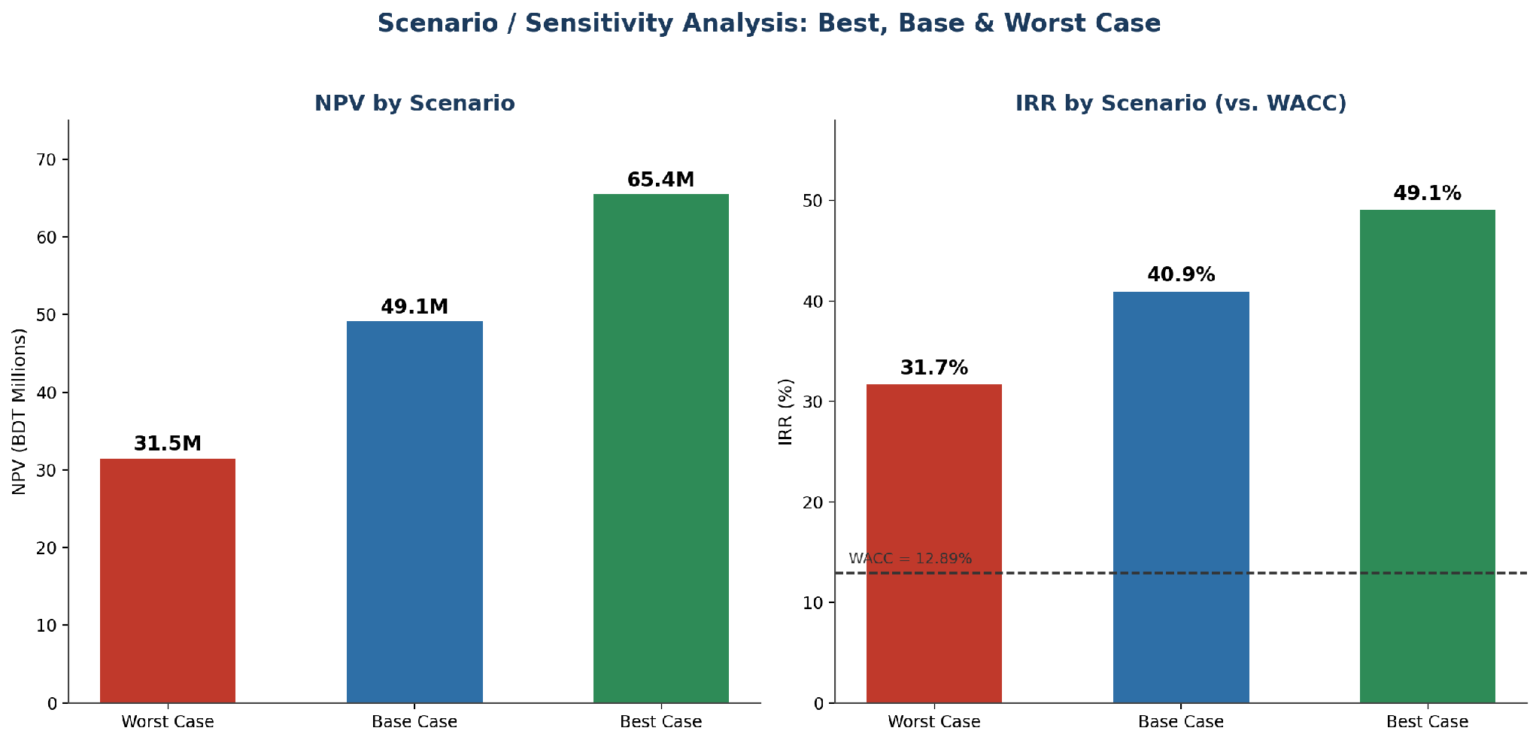
Part 7
Scenario analysis: the decision survives three operating environments
Scenario
Revenue change
Opex change
NPV
IRR
Best
+15%
−5%
65.43M
49.07%
Base
As forecast
As forecast
49.11M
40.93%
Worst
−15%
+10%
31.48M
31.71%
All scenarios remain above WACC and positive on NPV.
Provided scenario / sensitivity analysis

Slide 29
Part 7
Risk view: downside case remains investable, but execution risk is real
Worst-case economics
Residual risks not fully quantified
NPV
IRR
Regulatory changes in parking enforcement
Construction / installation delays
Technology and vendor reliability
Demand adoption and pricing resistance
Maintenance or wage inflation above plan
BDT 31.48M
31.71%
Still positive
Still > 12.89% WACC
Modeled adverse drivers
Revenue −15%
Opex +10%
The financial thesis is resilient, but final investment should be gated by execution validation.
Takeaway

Slide 30
Recommendation: ACCEPT
Part 8
01
Value creation
NPV ≈ BDT 49.1M
ACCEPT
02
Return
IRR 40.93% vs 12.89% WACC
Base case
NPV > 0
IRR > WACC
Payback is short
Worst case still positive
03
Recovery
Payback 2.66 years
04
Resilience
Worst-case NPV ≈ BDT 31.5M

Slide 31
Thank You
Questions & Discussion
Smart Parking System Near Square Hospital | FIN101, Group 03 | Summer 2026
Muhammad Abdul Kayum • Zarin Tasnim Maisha • Mahina Hoque • Lameya Suman Mahin • Linkon Saha • Nawar Salsabil Fiha • Nafisa Tasnim Rafia • Fatimah Atiyyatul Karim
Notes:
Thank the professor and open the floor for questions. All eight members should be ready to field questions on their assigned section.

